Slide 1
Interrupt mechanism

Slide 2
Microprocessor/ Microcontroller
service
service
service
Device 1
Device 2
Device N
A single microcontroller can serve several devices. There are two methods to provide services are :

Slide 3
Interrupt :
In interrupt method, whenever any device needs its service, the device notifies the microcontroller by sending it an interrupt signal
Upon receiving an interrupt signal, the microcontroller interrupts whatever it is doing and serves the device.
Program associated with interrupt is called as ISR (interrupt service routine) .
Advantage of interrupt is that the microcontroller can serve many device as per priority.
In this method microcontroller can ignore the interrupt request of device
ISR (Interrupt Service Routine :
For every interrupt, there must be an interrupt service routine (ISR), or interrupt handler.
When an interrupt invoked, the microcontroller runs the interrupt service routine.
Program
ISR
Interrupt
RETI

Slide 4
CS:
A processor is busy with its program execution
Program
ISR
An interrupt is occurred during the execution
IP
PUSH Return Addr
An interrupt is a condition that make the processor to execute ISR
Interrupt
Program is stored into the Code segment and IP is used to give the offset address
INT n
IP = ISR Addr
There are n interrupts i.e. 256 (0-255)
RA
Whenever interrupt occurred processor will executes its current instruction and entered into the ISR of respective interrupt.
IP = Return Addr
For this processor assign ISR Addr to IP.
POP Return Addr
Then processor executes the ISR of respective interrupt
After completion of ISR processor has to return to the main program and for that it requires return address (RA)
RET
To get return address processor has to save this next instruction address or return address.
Before entering into ISR of respective interrupt processor will save next instruction address i.e. RA on to the stack.
And when processor returns from the ISR execution it will refer the saved return address.

Slide 5
CS:
It is not always necessary that, ISR and main program are in the same code segment
Program
Return Addr
ISR
IP
PUSH CS
PUSH IP
When ISR and main program are in the same code segment it is called as intra segment
Interrupt
ISR Addr
INT n
Only IP will change CS will remains same
CS
IP
RA
When ISR and main program are in the different code segment it is called as intersegment
CS
IP
IP and CS both will change.
POP CS
POP IP
Return Addr
Normal jumps of 8086 can be in intersegment or intra segment
*** but every 8086 interrupt is in intersegment branch. Which means CS and IP both will change.
Return Addr

Slide 6
CS:
CS and IP are the 16 bit registers are used to store 16 bit number
Program
Return Addr
ISR
CS
CSH | CSL
IP
PUSH CS
PUSH IP
ISR Addr
Interrupt
IP
IPH | IPL
INT n
CS
IP
RA
SP – 4 | IPL
SP – 3 | IPH
SP – 2 | CSL
SP – 1 | CSH
CS
IP
POP CS
POP IP
Return Addr
Return Addr
There are total 256 interrupts and processor has to remember addresses of all interrupts ISR
To store those addresses IVT is used i.e. Interrupt Vector Table
*** IVT is not used to store ISR of an interrupt. It is used to store address of that ISR .*****
IVT is also stored into the memory*******

Slide 7
IVT
Whenever interrupt occurred, processor save the next instruction address and first go to the IVT
00000H
IPL | INT 0
IPH
CSL
CSH
45 | INT 1
23
00
10
 | INT 255
00001H
From IVT processor will take the ISR address and then it will jump to that ISR for execution.
00002H
00003H
For example, INT 1 interrupt occurred, and ISR address of this interrupt is 12345 H
00004H
00005H
CS = 1000
IP = 2345
00006H
00007H

Slide 8

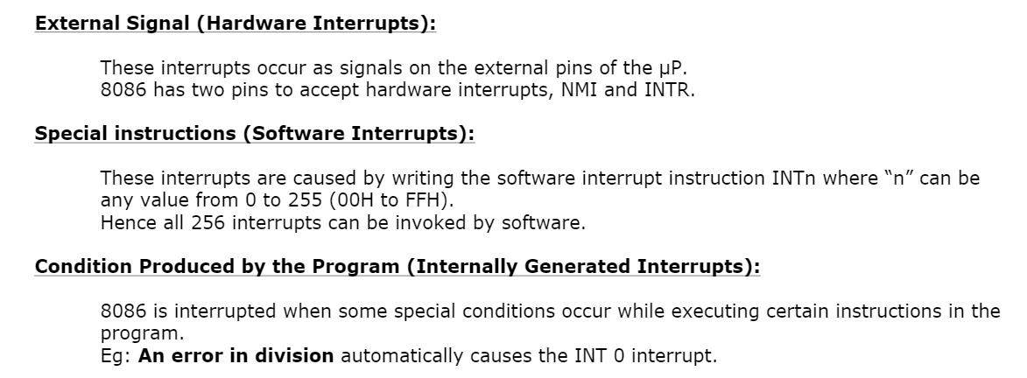

Slide 9
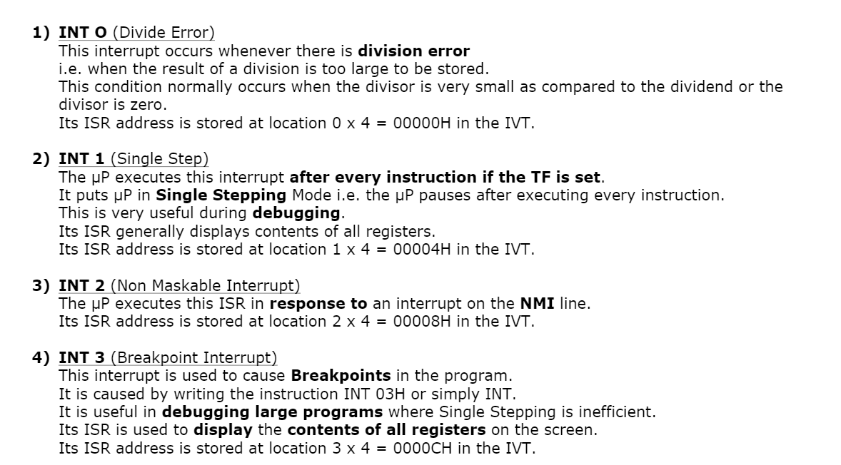
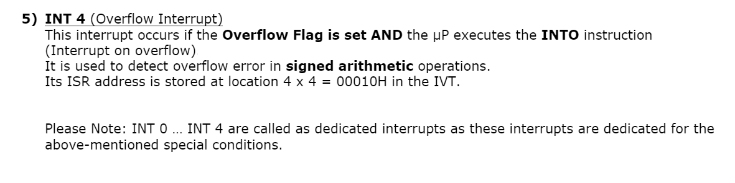

Slide 10
Program
ISR
RET : This instruction is used for normal branching
IRET : This instruction is used for Interrupt branching
also it used to reset the IF flag.
Interrupt
When processor entertained an interrupt before executing ISR, Processor make IF = 0, to inform about the interrupt execution.
Which means at a time only one interrupt will execute.
RET
IRET

Slide 11
(V)- Vectored- fixed ISR
(NV)- Non Vectored – not fixed ISR – 255 (interrupt)
8086 has two interrupt pins:
NMI – Non maskable interrupt (NMI) is a vectored interrupt which means every ISR has a fixed ISR address in vectored table.
INTR – INTR is maskable non vectored interrupt where ISR of this interrupt is available anywhere in the memory. There is fixed ISR address.
with INTR pin 255 interrupts can be connected.
To manage 255 (00-FF) interrupt request there is an external chip interface with 8086 is called as programmable interrupt controller (PIC) – 8259.
8259 is responsible to handle interrupt request and transfer it to the processor through INTR pin.
After receiving interrupt on ISR processor ask vector number by sending two INTA signals.
On first INTA signal 8059 calculates ISR address and on second INTA pulse 8259 send 8 bit vector number on data bus.
8086
Keyboard
(V)
NMI
‘n’ 8-bit data
8259
IR0
INTA
(NV)
INTR
Mouse
IR7
Accept Interrupt on behalf of 8086 is the main job of 8259 PIC.
8259 is not responsible for ISR execution.

Slide 12
8259 has important properties :
P T M V
Priority
Trigger
Masking
Vector No.
Processor can change priority by sending commands.
8086
8259
(V)
NMI
Default Priorities
Commands
IR0
Highest Priority
Processor can mask or unmask of an interrupt by sending commands.
INTA
(NV)
Processor can change triggering of an interrupt by sending commands. (edge or level)
INTR
Lowest Priority
IR7
Processor can send vector number of interrupts by sending commands.
8259 is used to increase the interrupt and single 8259 chip having only 8 interrupt connection hence cascading is used.
At the time of initialization processor will send interrupt vector number hence, 8259 initialization is compulsory and very important.
Since there are 8 IR, during initialization you have to send only first vector no. for IRO, remaining vector numbers are taken automatically in sequence.
8259
Slave
IR0
Vector No. for IR0 = 40H
----II------------- IR1 = 41 H
.
.
Vector No. for IR7 = 47H
8259
Master
1 Master X 8 Slaves X 8 interrupts = 64 interrupts

Slide 13
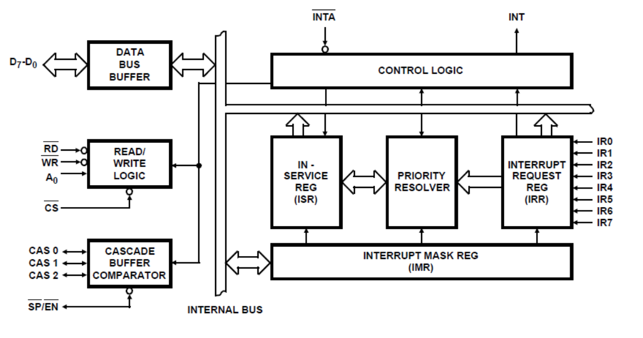

Slide 14
When interrupt occurred, which option is selected???? Pin or bit ?????
Pin
BIT
IR0
0
0
0
0
0
0
0
0
IR0
0
0
0
0
0
0
0
0
1
IR1
IR1
Priority
Resolver
Register
IRR
Interrupt
Request
Register
(8 bit)
IR2
ISR
In
Service
Register
(8 bit)
IR2
1
IR3
IR3
When two interrupts are occurred, at a time?????
IR4
IR4
IR5
IR5
As per priority IR0 having highest priority than IR2 so interrupt request is send for IR0 and being serviced.
IR0 pin goes low
IR6
IR6
IR7
IR7
But IR2 pin remains high because we don’t know how much time will take by ISR of IR0 for execution.
Interrupt Mask Register(8 bit)
As per priority IR0 having highest priority than IR2 so interrupt request is send for IR0 and IR0 bit set in ISR reg.
0 | 0 | 0 | 0 | 0 | 0 | 0 | 0
7 | 6 | 5 | 4 | 3 | 2 | 1 | 0

Slide 15
Process when there is only one interrupt request
1. All bits of all three registers are 0 means there is no interrupt request, no interrupt is being serviced and no masked interrupt
IR0
0
0
0
0
0
0
0
0
IR0
0
0
0
0
0
0
0
0
1
1
IR1
IR1
Priority
Resolver
Register
IRR
Interrupt
Request
Register
(8 bit)
IR2
ISR
In
Service
Register
(8 bit)
IR2
2. When interrupt occurred on any line, the corresponding bit will be set in IRR register.
IR3
IR3
IR4
IR4
IR5
IR5
IR6
IR6
IR7
3. IRR send request to processor through INT pin which is connected with INTR of processor.
IR7
4. Once received acknowledgement from processor through INTA bar pin 8259 set respective bit of ISR
Interrupt Mask Register(8 bit)
0 | 0 | 0 | 0 | 0 | 0 | 0 | 0
7 | 6 | 5 | 4 | 3 | 2 | 1 | 0

Slide 16
1. All bits of all three registers are 0 means there is no interrupt request, no interrupt is being serviced and no masked interrupt
Process more than one interrupt requests simultaneously.
2. First interrupt occurred on IR0 line, the corresponding bit will be set in IRR register.
IR0
0
0
0
0
0
0
0
0
IR0
0
0
0
0
0
0
0
0
1
1
IR1
IR1
Priority
Resolver
Register
IRR
Interrupt
Request
Register
(8 bit)
IR2
ISR
In
Service
Register
(8 bit)
IR2
4. Second interrupt occurred on IR4 line.
IR3
IR3
IR4
IR4
1
5. IR4 is also set in IRR.
IR5
IR5
Which interrupt should get first priority??????
IR6
IR6
IR7
IR7
6. In this situation 8259 follows default priority if there is no programmable priority.
7. IR0 having highest priority that IR4, hence 8259 will send interrupt request for IR0 and make IR0=1 in ISR after receiving acknowledgement from processor.
Interrupt Mask Register(8 bit)
8. After completion of IR0 ISR execution 8259 will send interrupt request for IR0
0 | 0 | 0 | 0 | 0 | 0 | 0 | 0
7 | 6 | 5 | 4 | 3 | 2 | 1 | 0

Slide 17
Process when one interrupt being serviced, one interrupt in waiting state and one more interrupt occurred.
1. Currently IR2 is being serviced, and IR 4 is in waiting state.
2. IR1 has accrued.
3. 8259 will check priority within IRR register. And according to default priority IR1 priority > IR 4 priority, hence 8259 consider IR1
IR0
0
0
0
0
0
0
0
0
IR0
0
0
0
0
0
0
0
0
IR1
1
IR1
1
IR2
1
IRR
Interrupt
Request
Register
(8 bit)
IR2
**** IMP****
ISR
In
Service
Register
(8 bit)
Priority
Resolver
Register
IR3
IR3
4. 8259 also compare the being serviced IR priority with requested IR priority.
IR4
IR4
1
IR5
IR5
IR2 < IR1
IR6
IR6
5. 8259 send interrupt request for IR1
IR7
IR7
6. On first INTA bar pulse processor ask vector no. and on second clock pulse 8259 provide vector no. for IR 1 and set IR1 in In Service reg.
7. Now processor call ISR of IR1 execute it and return to IR2 and execute it.
Interrupt Mask Register(8 bit)
0 | 0 | 0 | 0 | 0 | 0 | 0 | 0
7 | 6 | 5 | 4 | 3 | 2 | 1 | 0

Slide 18
Process when one interrupt being serviced, one interrupt in waiting state and one more interrupt occurred but one of them is maskable.
1. Currently IR4 is being serviced, and IR5 is in waiting state.
2. IR3 has accrued.
3. 8259 will check priority within IRR register and according to default priority IR3 priority > IR 5 priority, hence 8259 consider IR3
IR0
0
0
0
0
0
0
0
0
IR0
0
0
0
0
0
0
0
0
IR1
IR1
IR2
IRR
Interrupt
Request
Register
(8 bit)
IR2
ISR
In
Service
Register
(8 bit)
Priority
Resolver
Register
IR3
1
IR3
0
4. 8259 also compare the being serviced IR priority with requested IR priority.
IR4
1
IR4
IR5
IR5
1
IR6
IR6
**** IMP****
IR7
IR7
6. Before above comparison 8259 first check whether requested interrupt is masked or not
7. In this example IR3 is maskable interrupt which means processor is not interested to in this interrupt hence 8259 make 0 for IR3 in IRR.
Interrupt Mask Register(8 bit)
0 | 0 | 0 | 0 | 1 | 0 | 0 | 0
7 | 6 | 5 | 4 | 3 | 2 | 1 | 0

Slide 19
INTA
8059
Slave 0
50
0
0
0
50←
IR0
CD
Processor
40
41
42
43
44
45
46
47
IR0
000
000
60
0
0
0
0
0
0
0
INTA
IR0
Floppy
IR1
8059
Slave 1
000
IR2
INTA
001
IR3
Keyboard
50←
IR4
Mouse
000
8259 Master
IR5
IR6
70
0
0
0
0
0
0
0
Printer
IR0
IR7
8059
Slave 7
CAS0 CAS1 CAS2
0 0 0
INTA
007
000

Slide 20
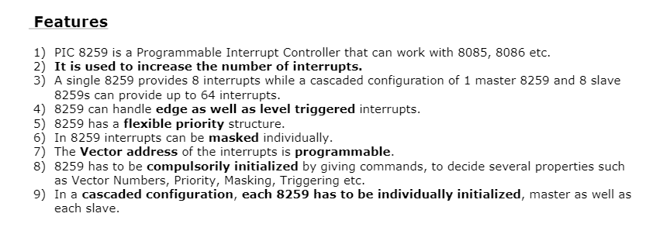

Slide 21
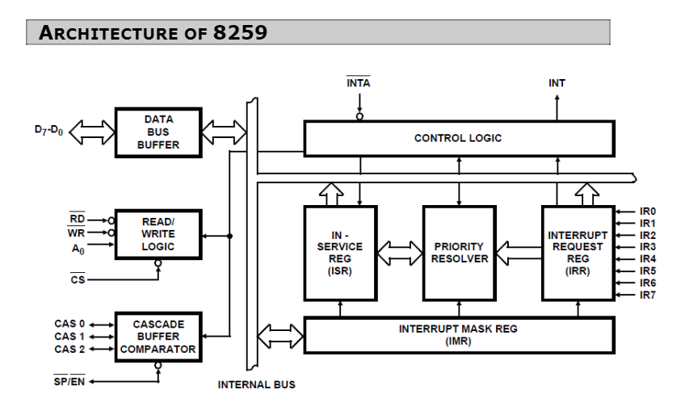

Slide 22
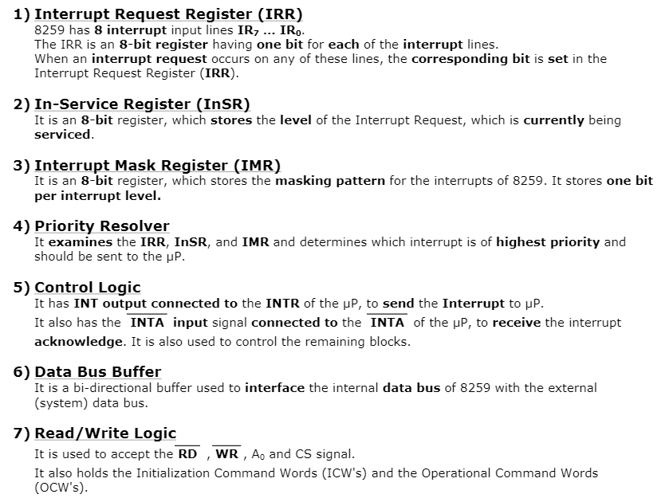

Slide 23
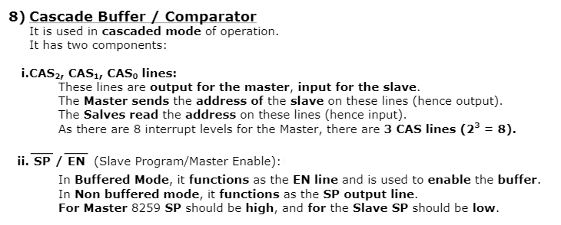

Slide 24
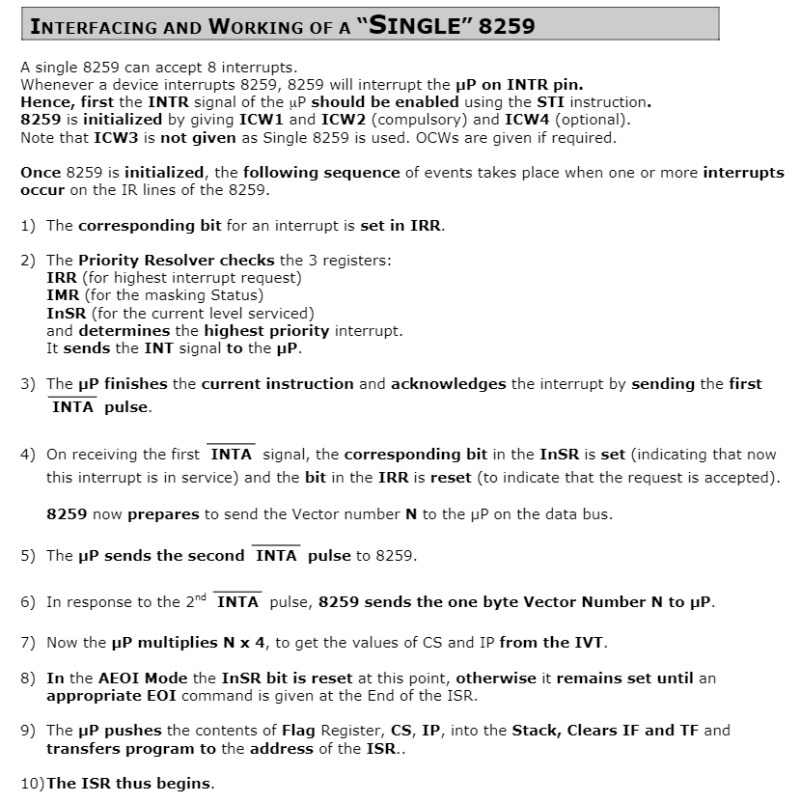

Slide 25
INTA
8059
Slave 0
40
IR1
Processor
20
21
22
23
24
25
26
27
IR0
000
Usb
000
50
0
0
0
0
0
0
0
INTA
IR2
IR1
8059
Slave 1
Printer
IR2
INTA
001
IR3
IR4
8259 Master
IR0
IR5
8059
Slave 5
Keyboard
70
0
0
0
0
0
0
0
IR6
005
IR7
CAS0 CAS1 CAS2
INTA

